Slide 1
Template slide deck for leadership/management engagement
NHS Flex for the Future programme
These slides are designed for you to use to engage leaders and managers within your organisation with the project and the need for action on flexible working
Please edit and adapt to fit your own needs

Slide 2
Why are we doing this?
Include examples from your own organisational data to highlight e.g. staff satisfaction / turnover / attraction

Slide 3
Why are we doing this?
63% of full-time workers already work flexibly
87% of UK employees either work flexibly or would like to
1 in 4 of full-time employees would prefer to work part-time & are willing to earn less to do so
Data from Timewise – The Talent Imperative (2017)
75% of workers don’t want organisations to return to “business as usual” following lockdown*
48% of parents and carers hope to make changes to their working patterns after the Covid-19 pandemic**
HR directors expect 70% of the workforce will have some form of flexible arrangement after Coronavirus restrictions are fully lifted – a 45% increase from pre-March 2020***
*Business clear air taskforce (2020)
**Working families survey (2020) *** Research conducted by Pure Profile (2020)

Slide 4
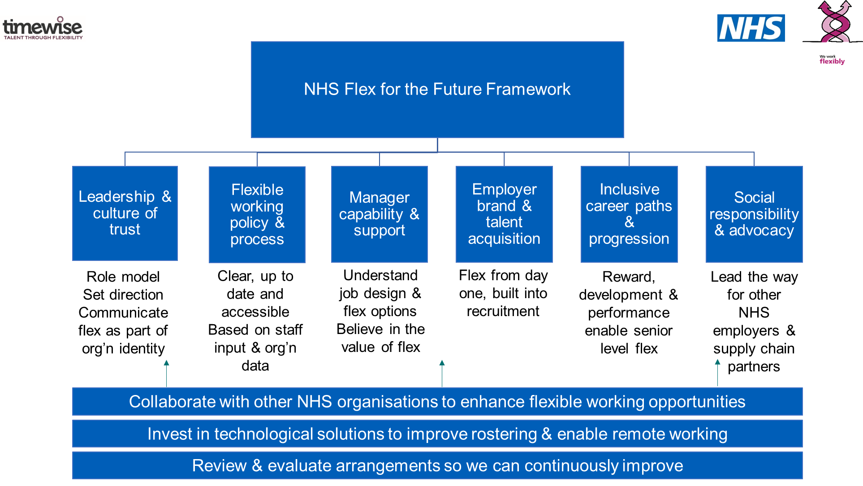

Slide 5
Benefits of flexible working – the case for change
Better work-life balance
Increased job satisfaction & motivation
Enabling equitable job and career opportunities and supporting a reduction in the Gender Pay Gap
Attracting and retaining high quality candidates and a diverse workforce
Reductions in stress and absenteeism
Reductions in carbon footprint
Decreased financial burden
Which leads to more engaged staff and better patient experience
Notes:
(2 mins/Total run time = 42 mins - 1012)
Benefits to flexible working – case for change: Flexible working has several benefits to both the individual, organisation and wider system including:
Better work-life balance
Increased job satisfaction, motivation and productivity, which in turn supports a better experience for our patients, service users and their families and carers
Enabling equitable job and career opportunities and supporting a reduction in the gender pay gap by offering more working options in roles at all levels across an organisation
Attracting and retaining high quality candidates and a diverse workforce with organisational memory, valued skills and experience within a competitive employment market
Reductions in stress and absenteeism
Reductions in carbon footprint
Decreased financial burden (e.g. travel, office space, turnover, recruitment, lost productivity).

Slide 6
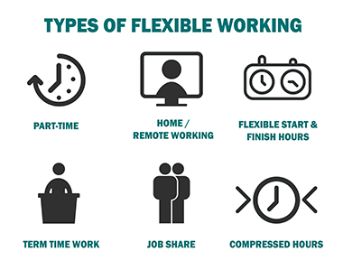
Understanding types of flexible working
WHERE Remote working; home; mobile; other offices
WHEN Flexible start/finish times; annualised; compressed; shift choice; part-time
HOW Job-sharing; job-splitting; project-based; contract; bank
Notes:
(2 mins/Total run time to 29 mins/ to 0959)
AMY
Lots of focus during the pandemic on where – wfh, hybrid working. But important not to equate working remotely with flexible working.
Types of flex ….
Then the WHERE /WHEN/ HOW framework helps you to think about flexible working options.
WHERE in current context means WFH but when back to BAU could also be use of other office space, co-working space or a coffee shop
WHEN during this time, lots of people need flex on WHEN they are working. How flexible can the role be in terms of working hours? This can apply to shift based and non shift based roles, and includes working reduced hours (part time)
HOW is about your working arrangement – ways of working e.g. are you project based / bank staff / contract or secondment?
And we know some of you are concerned about the impact of long or extreme hours, and the fact you are never ‘off work’ when you work at home
When you are discussing flexibility with individuals, remember these options which can help narrow down the flex options which will work for you and them.
For some of these options, for example reducing the number of hours you work each week, you will need to go through a formal process to get something in place.
However for many options in the first two categories, can be agreed between you and the individual informally.

Slide 7
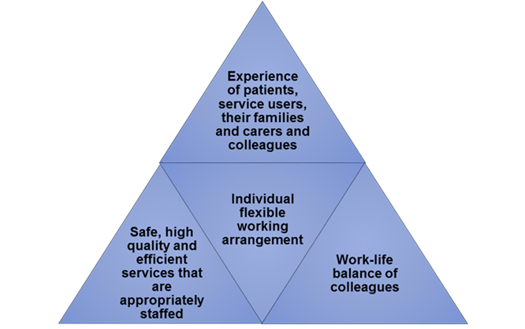
Where flexibility works
Where flexibility works
Notes:
(2 mins/Total run time = 56 mins - 1026)
Good flexible working arrangements will always balance the needs of the individual with three key organisational factors; patient/service user and staff experience, service delivery and capacity.
Managers understanding job design & flex options. And believing in the value of flex
So the role of managers is supporting individuals and teams with their working patterns and job design right now.
We have used this model in the past to explain that flexibility only works when it helps meet both the organisation’s need AND the individual need.
An organisation is not doing an individual any favours by agreeing a working pattern which won’t work with what you expect them to deliver. This has to be a win-win.
So managers are key drivers of change as they can work with team members to find that sweet spot where they can work flexibly and deliver. Providing line manager training and guidance are examples of actions you can take to drive up capability amongst managers in relation to flexibility at work.

Slide 8
Your role in leading the change
Lead by example
Be open about your flexibility & how you manage your well-being
Show trust
Trust people to do their jobs on a flexible basis
Reward & recognise
Set clear, outcomes-based objectives
Don’t wait for people to ‘earn it’
Be transparent about your working patterns - let the team know when and where you are working and ensure that everyone else does the same
Consciously reward and recognise people for the outcomes they are achieving - not the additional hours or always being present
Book non-work time in your diary
Leave loudly or log off visibly
Be clear you don’t expect replies out of hours

Slide 9
Your role in leading the change
Drive the conversation
Talk about flexible working and wellbeing
Discuss flex at team level
Regularly evaluate & discuss working arrangements with your team
Trial, learn & share
Learn from how others are making their roles more flexible
Ensure it is being brought up and discussed in 121s and wellbeing conversations – by you, and by your team members
Ask your people how/where/when they find they work best
Explore the options which would work best for your team & try them!
Make it a standing agenda item with your team, monitoring their progress
Talk to other managers and teams about what you are trying
Discuss successes and challenges – don’t be afraid to review, tweak and improve arrangements

