Slide 1
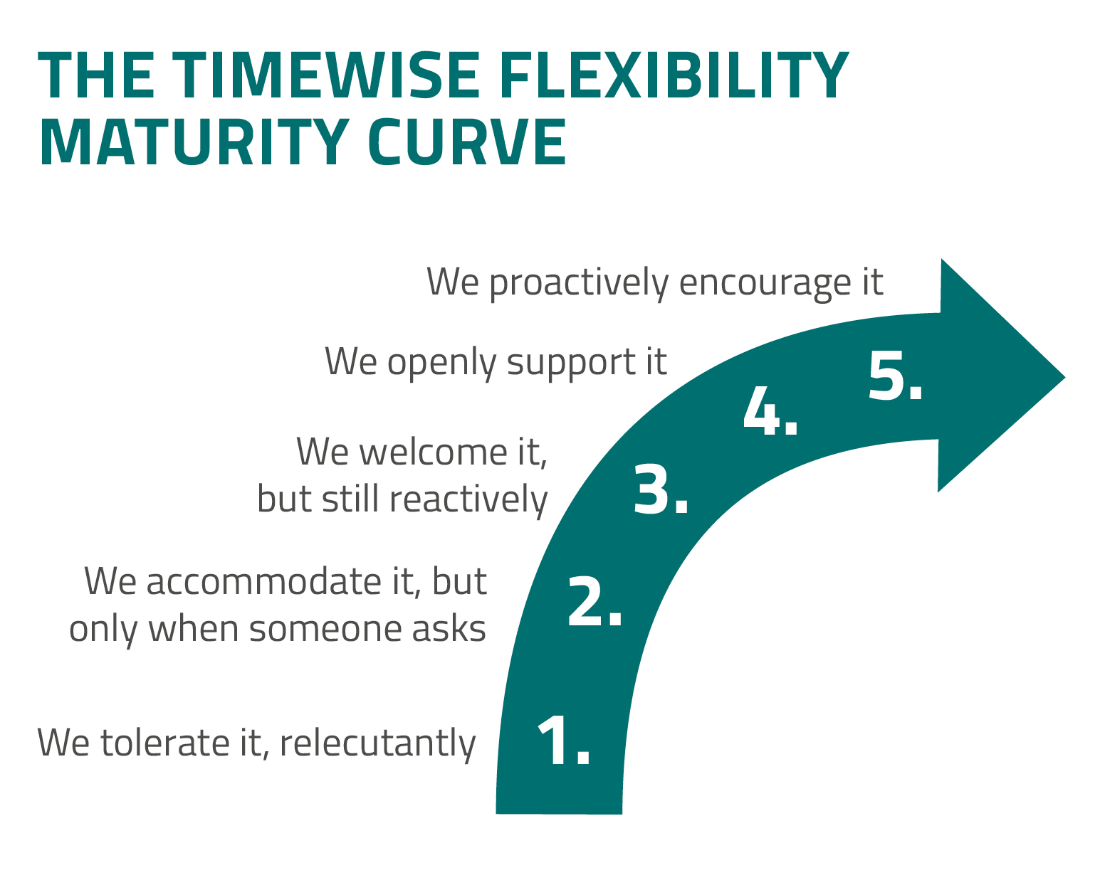
Where are you on the curve?
Copyright © 2022 Timewise All rights reserved. Prohibited to copy, share or use without prior written permission of Timewise.

